Slide 1



Reconsidérer les flux continent-océan
Catherine Jeandel& Eric Oelkers (2014)
CNRS, LEGOS, Observatoire Midi-Pyrénées, Toulouse University
CNRS, GET, Observatoire Midi-Pyrénées, Toulouse University
Thank you to:
K. Tachikawa, F. Lacan, B. Peucker-Ehrenbrink, M. Jones, C. Pearce, M. Grenier
Seminaire LEGOS, 7 novembre 2013
Notes:
With this talk, I will propose you our recent thoughts regarding L to O fluxes…Before starting, thanks; This issue is Geotraces /IMBER and LOICZ relevant…

Slide 2

Weathering Processes….
Mechanical Weathering or Denudation
Chemical Weathering
Dissolved load
Particulate Transport
Ocean
Notes:
Two main processes are weathering the earth surface: chemical… and mechanical..

Slide 3
Global mass fluxes to the ocean
Solid flux
= 30 times the dissolved one
= 50 times the atmospheric one
Notes:
Weathering processes yield a dissolved flux of 1 GT/Y , bedload 10, Suspended one 20…all together the solid fux annually discharged to the ocean is 30 times the liquid one

Slide 4
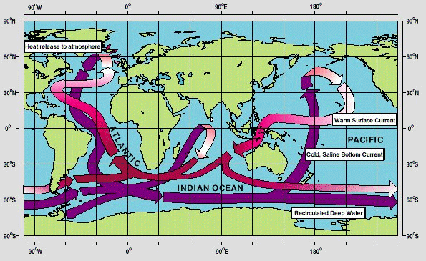
Along the general oceanic circulation
Field Observations (1)
-15
-3.8
Nd concentration is
only doubling
Lacan et al., Chem. Geol., 2012
ε_{Nd} oceanic distribution follows the general circulation
(in the modern ocean as in the sediment)
But its concentration doubles only
Nd paradox
Notes:
Let’s start with the tracer which clearly revealed that land to ocean fluxes had to be reconsidered. Here is represented (purple arrow) the simplified scheme of the general oceanic circulation…epsNd values are superimposed, they represent the average atlantic and average north pacific…also the gradient is less strong than on the continent, there is a gradient. Explaining it requires to add a huge amount of Nd to the seawater…which is not reflected in the concentration variation which only double between here & here…

Slide 5
Imbalanced Nd oceanic budget
Field Observations (2)
Dust + river inputs : not sufficient
Missing term: river solid load and/or sediments
deposited on the margins
Lacan&Jeandel, 2001;Tachikawa et al, 2003
Notes:
This map here shows the distribution..along the margins, represented as epsNd (a définir) . It shows that values around north atlantic….So, when « weathered » one can easiliy imagine that they will not introduce the same « coulour » in the ocean

Slide 6
Field Observations (4)
Lacan &J eandel, 2001, 2005
Van der Flierdt et al, 2004
Carter et al, 2012
Rickli et al, 2009, 2011
Grasse et al, 2012
Wilson et al, 2012
Grenier et al, 2013
…/…
« BOUNDARY EXCHANGE »
- quantifiable using Nd IC
- invisible with concentrations only
BE is THE major source term (>95% of the total : 1.1 10¹⁰ g(Nd)/an).
Continental inputs & margins: major for Nd
(only 3% dissolution)
And for the other chemical elements?
F_{R}
F_{A}
F_{BE}
Arsouze et al, 2009
Notes:
Nd paradox+ several observations as the one observed for AAIW at different oceanic places conducted us toi propose that process controlling Nd at the continent/ocean interface is BE

Slide 7
Strontium
Field Observations (5)
Ocean ⁸⁷Sr/⁸⁶Sr is homogenous at 0.70916
The primary controls were accepted as dissolved riverine input (⁸⁷Sr/⁸⁶Sr ≈ 0.7136) and hydrothermal exchange (⁸⁷Sr/⁸⁶Sr ≈ 0.7029)
However, the unradiogenic flux is a factor of 3 too low to balance the inputs
Therefore, part of the story is missing (as for Nd oceanic budget)
Notes:
Let’s now discuss Sr oceanic budget. Because Sr is definitely more soluble than Nd, we can expect a different picture…First of all, it is clearlky moer homogeneously distributed. HOWEVER….

Slide 8
Strontium Imbalance: hypotheses
Field Observations (6)
Current riverine fluxes may be elevated due to a recent glaciation (Vance et al., 2009)
Subsurface weathering of volcanic islands are not included (Allègre et al., 2010)
Volcanic particulate riverine material could also contribute unradiogenic Sr
Notes:
What are the hypotheses that could explain this “Sr missing term”?

Slide 9
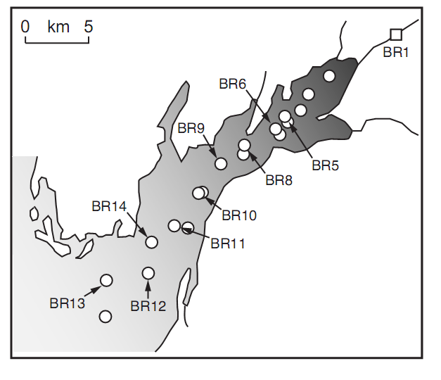
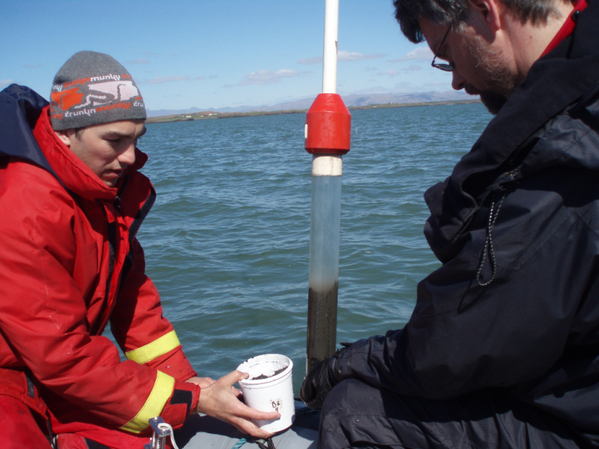
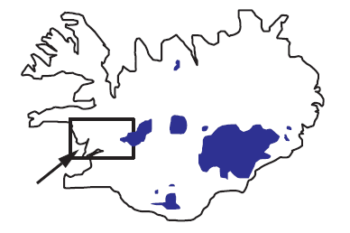
Sampling in Borgarfjörður estuary
(Morgan Jones’ current work)
Field Observations (7)
Notes:
I will show you now results from field observation…(again). Here we are in an icelandic estuary. Samples for Sr isotopes were collected at all these points

Slide 10
Field evidence of particulate dissolution in the ocean: Borgarfjordur Estuary (1)
Field Observations (8)
Estuary water as a function of salinity
Sr^{87/}Sr⁸⁶ as a function of salinity
Notes:
Results are reported now. Left: Cl concentration = f(km from the river). The salinity front occurs between 6 and 8 km…Right: That’s also where the Sr 7/6 ratio strongly increases!

Slide 11
Field evidence of particulate dissolution in the ocean: Borgarfjordur Estuary (2)
Field Observations (9)
Sr⁸⁷/Sr⁸⁶ in estuary water as a function of river water fraction
Sr⁸⁷/Sr⁸⁶ attributable to particulate dissolution
50% of Sr from dissolution of particulates
As for Nd, dissolution of lithogenic material
is occuring at the land/ocean interface
Notes:
Lefts: distribition of the 7/6 as a function of the river content in sw….right, comparison between the fluid mixing model and what is observed in the estuary: the excess of Sr is hudge and could be attributed to the dissolution of basaltic particles

Slide 12
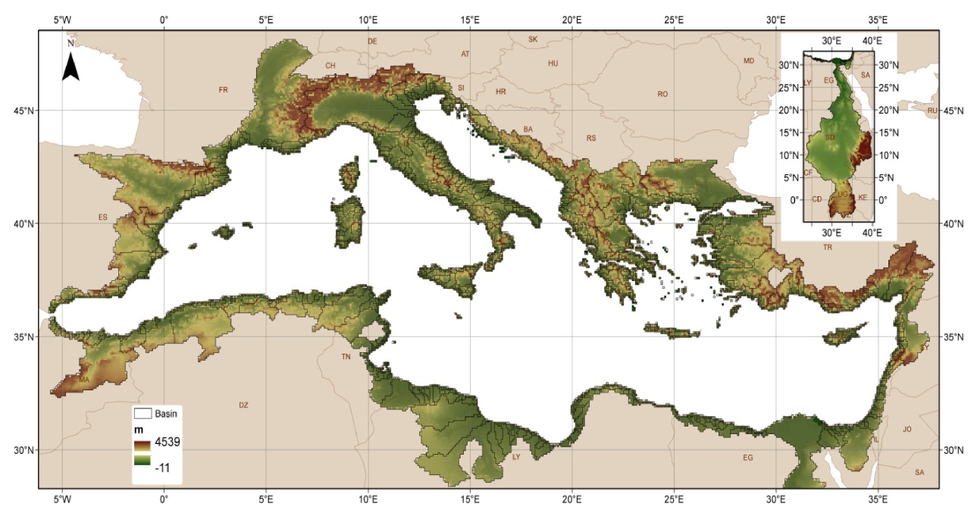
Silica budget (Mediterranean Sea) 10⁶ Moles/y
Field Observations (11)
Total dissolved river input = 24,300-118,700
51,000-127,000
Total Atmospheric input =709-7,350
288,000- 424,000
Si_{out} = 2 to 8 x (Si _{in})
Total ext. inputs = 25,000-126,000
Si missing = 35,000-348,000
Durrieu de Madron et al, 2009
Notes:
Still in the Med Sea, more puzzling perhaps is the Si budget…Gibraltar…

Slide 13
Source of the Si missing?
Range required: 3.5 10¹⁰ à 3.4*10¹¹ moles/y
Field Observations (12)
Total river solid discharge = 0.73 10⁹ T/y (Ludwig et al , 2003)
Dissolution of only 1% of this flux
8.3 10¹⁰ mol/y SiO₂
Same result considering
Release from 1% of the first 10 cm of sediment deposited on the margins (consistent with Tréguer and de la Rocha, 2012)
Notes:
What could be the source of this missing Si?

Slide 14
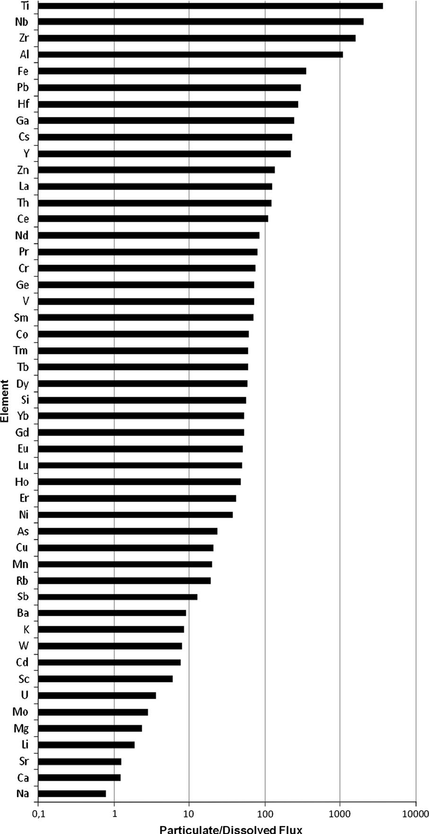

Particulate/Dissolved flux
First Intermediate conclusion
Field Observations (14)
Fe
Fe
Particulate transport dominates
the flux of most metals to the ocean
(Oelkers et al, 2011)
The release in seawater of even
a tiny fraction (~1%) of this material
deposited on the shelf/margins may
impact oceanic
isotopic & element budgets
(Jeandel et al, 2011,
Jeandel&Oelkers, 2014)
Th
Nd
Si
Sr
Particulate/dissolved flux
Notes:
I am now over with the field observations and this graph resumes that …

Slide 15
Questions
Processus: Desorption or Dissolution?
Which phase (Fe-Mn coating) or mineral (primary or secondary)?
Kinetic?
Notes:
The question now is related to the processus yielding this release…In order to face this issue, we realised some batch experiments…

Slide 16
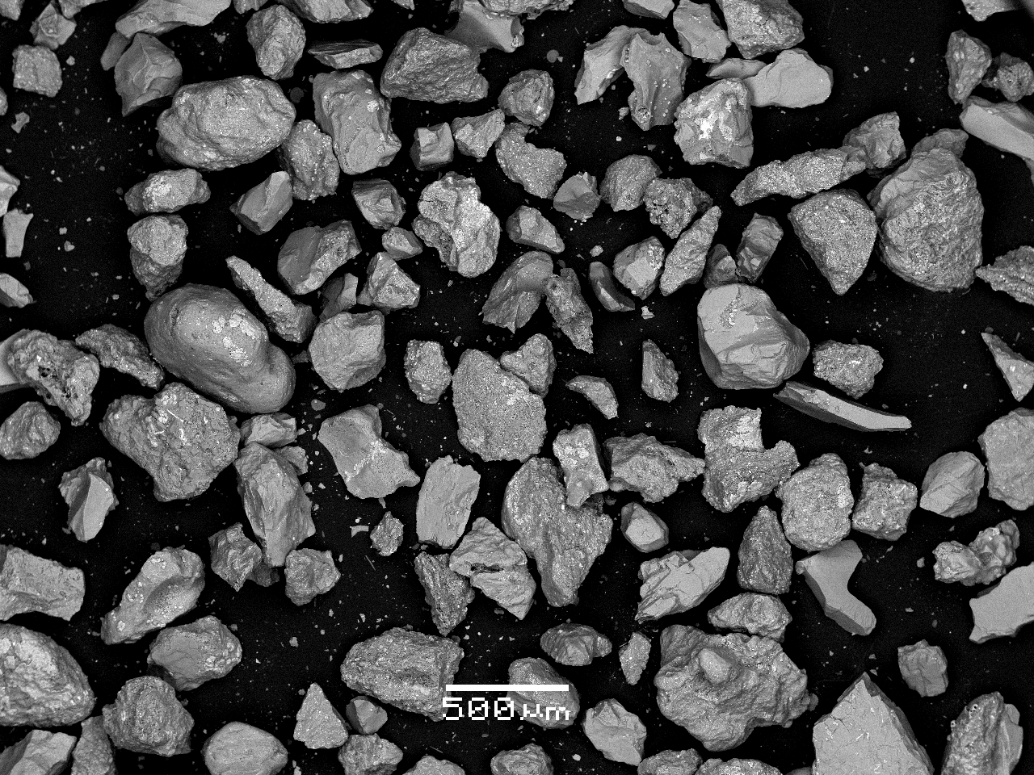
Batch experiments
(Jones et al, 2012a,b; Pearce et al, 2013)
Experiments (1)
Sediment samples were mixed with open ocean seawater
(water of southern origin, ε_{Nd} = -9.6)
Marine top core from Kerguelen plateau (station C1, ε_{Nd} = -1.4)
Estuarine sediment from SW Iceland (ε_{Nd} = +7.2)
Riverine bedload Sediment from SW Iceland (ε_{Nd} = +7.5)
-9.6
Batch reactors
30 l SW
1g/l
4 months
-1.4 to +7.5
Sr, REE, Si aliquots taken weekly
Nd IC aliquots taken every 2 weeks
Notes:
The principle of our experiments is resumed here

Slide 17
Nd results (Pearce et al, 2013)
Experiments (4)
ISOTOPE
7.2
Iceland Est.
Iceland Riv.
-1.4
Kerguelen
1 month
Initial Sw value = -9.6
Hours
CONCENTRATION
IC: Nd rapid release (0.2 to 2% of Nd contained in the KER basalt)
Cc: Nd scavenging after release: secondary phases =
REE phosphatemineral rhabdophane (REE(PO4)nH2O) ?
Hours
Notes:
Let’s now have a look with what we obtained for Nd parameters…

Slide 18
Silica release?
Experiments (6)
25°C
Si(OH)₄ x 20
5°C
Si(OH)4 x 10
Notes:
Moreover, here are the results obtained for silica…(temperature dependent!)

Slide 19
Experiments (7)
Notes:
In the framework of these experiments, we settled different means to observe the particles (and not only the seawater) here are EDS/EDAX results…

Slide 20
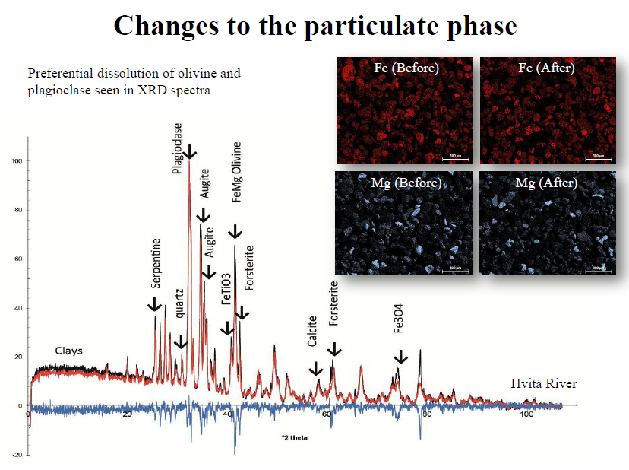
Experiments (8)
Plagioclase
Olivine
Notes:
XRD spectra are represented here, as well as elemental cartographies…Spectra: black, before, red after and the difference in blue..slight changes in the Fe and Mg content (more before than after)

Slide 21
Second Intermediate conclusion
* Particulate material is chemically reactive,
olivine & plagioclase being most susceptible to alteration
* Dissolution of lithogenic material followed by precipitation
of secondary phases, is strongly suspected
* Trace elements (Nd, Sr, Mn, Ba, Ni ) & major ones (Si, Mg)
are implied
* Kinetic is rapid (weekly to monthly scale)
Notes:
In order to broaden our observations, made on a local …and laboratory scales, we propose you now some global calculations…we focused these on Si cycle only, because Si is of prime importance for the ocean life and climate modelling

Slide 22
Other elements that are released
(similar experiments not shown here)
Mn
Ni
Relative concentration in seawater
Ba
Si

Slide 23
Conclusions & Consequences (1)
Conclusions
Weathering of the particulate load (suspended, bedload, margin sediments)
can significantly affect the oceanic budget of isotopes & elements
This processus -previously unconsidered- might help to balance
the marine Sr, Nd, Si cycles and likely Th, Ba, Mg…
Ni, Cu, Zn, Mn: Cameron, Little, Vance (all published in 2014)
The weathered fraction includes a significant lithogenic component
(feldspath and olivine being among the most sensitive)
Kinetic of this process is rapid (within a month)
Followed by secondary phase precipitation: might affect more the isotopic than the concentration budgets

Slide 24
Conclusions & Consequences (2)
Consequences
Marine Sr cycle: differences in the reactivity of basaltic
and crustal particles suggest that solid load weathering
might help account for part of the « missing Sr flux »
to the ocean. Impact on the geological reconstitutions?
Marine Nd, REE cycles: consistent with the
« Boundary Exchange » hypothesis. Impact on its use as paleo-tracer?
Marine Th isotopes: solid load weathering likely perturbates
the coastal ²³²Th/²³⁰Th. Impact on its use as particle dynamic tracer?

Slide 25
Conclusions & Consequences (3)
Consequences
Marine Si concentrations and isotopes:
This additional flux increases the Si input term, diminishes the Si residence time by 35 to 50%
(at steady-state; Jeandel et al, 2011; Tréguer & de la Rocha, 2012)
Impact on the biological pump
Impact on the CO₂ modern cycle
Impact on the climatic models

Slide 26
Conclusions & Consequences (4)
(many) Remaining Questions
Other elements?
Clearly, one should reconsider the land to ocean fluxes of all the elements, mostly those of the essential marine micro-nutrient
Particle speciation effect?
Working on this will allow the best modelling of the impact of
such release on a global scale, taking into account the
geochemical particularities of watersheds and margins…
Notes:
These questions can be gathered into 2 main axis..

Slide 27
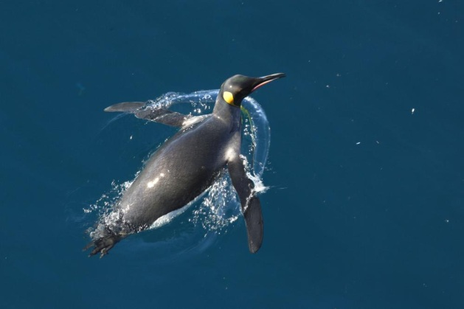
Thank you!

